Slide 1
Devil physics The baddest class on campus AP Physics

Slide 2
Lsn 3-7: Projectile motion is parabolic Lsn 3-8: relative velocity

Slide 3
Questions From Reading Activity?

Slide 4
Big Idea(s):
The interactions of an object with other objects can be described by forces.

Slide 5
Enduring Understanding(s):
All forces share certain common characteristics when considered by observers in inertial reference frames.

Slide 6
Essential Knowledge(s):
An observer in a particular reference frame can describe the motion of an object using such quantities as position, displacement, distance, velocity, speed, and acceleration.
Displacement, velocity, and acceleration are all vector quantities.
Displacement is change in position. Velocity is the rate of change of position with time. Acceleration is the rate of change of velocity with time. Changes in each property are expressed by subtracting initial values from final values.
A choice of reference frame determines the direction and the magnitude of each of these quantities.

Slide 7
Essential Knowledge(s):
Forces are described by vectors.
Forces are detected by their influence on the motion of an object.
Forces have magnitude and direction.

Slide 8
Learning Objective(s):
The student is able to express the motion of an object using narrative, mathematical, and graphical representations.

Slide 9
Learning Objective(s):
The student is able to analyze experimental data describing the motion of an object and is able to express the results of the analysis using narrative, mathematical, and graphical representations.

Slide 10
Learning Objective(s):
The student is able to represent forces in diagrams or mathematically using appropriately labeled vectors with magnitude, direction, and units during the analysis of a situation.

Slide 11
Projectile Motion is Parabolic*
* If we ignore air resistance and assume acceleration due to gravity is constant.
For the mathniacs:

Slide 12
Projectile Motion is Parabolic
* If we ignore air resistance and assume acceleration due to gravity is constant.
Where a and b are constant for a given velocity and angle.

Slide 13
Relative Velocity

Slide 14
Relative Velocity
Exploring how observations made in different reference frames can be related to each other through vector addition
It is extremely important to:
Draw a picture
Label the vectors with meaningful subscripts

Slide 15
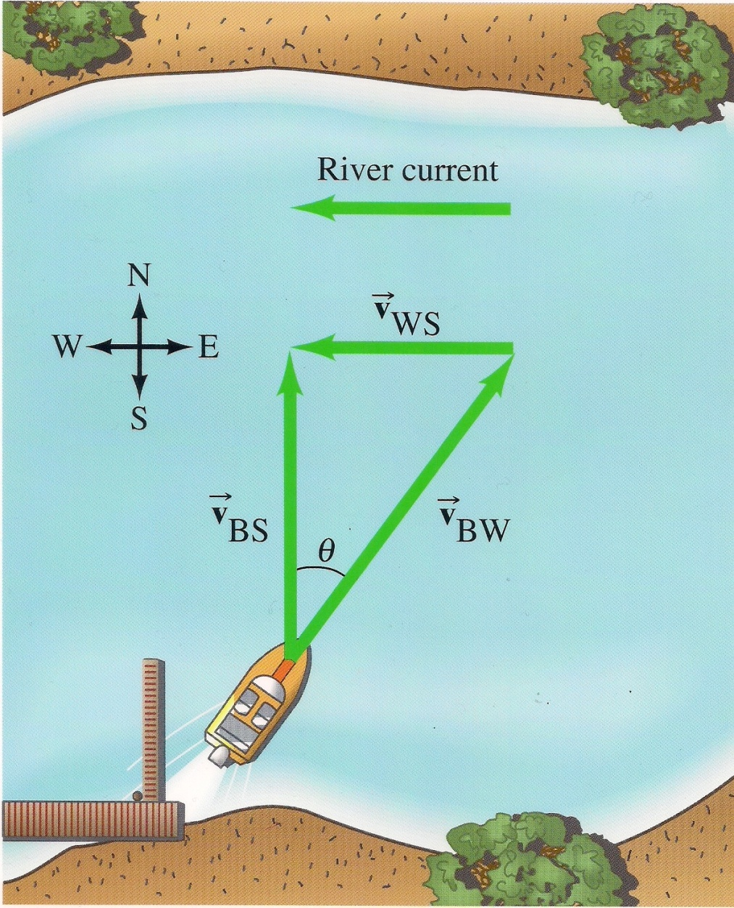
Relative Velocity
The first subscript refers to the object
The second refers to the reference frame
v_{BW} would refer to the boat with respect to the water
v_{WS} would refer to the water with respect to the shore

Slide 16
Relative Velocity
Here, you are adding v_{BW} to v_{WS} to get v_{BS}
Notice how the resultant, v_{BS}, will always have the same first subscript of the first vector and the same second subscript of the second vector.
Kinda like tail-to-head vector addition

Slide 17
Sample Problem #1
Homework #36

Slide 18
Sample Problem #2
Homework #43

Slide 19
Sample Problem #3
Homework #48

Slide 20
Sample Problem #4
Homework #51

Slide 21
Learning Objective(s):
The student is able to express the motion of an object using narrative, mathematical, and graphical representations.

Slide 22
Learning Objective(s):
The student is able to analyze experimental data describing the motion of an object and is able to express the results of the analysis using narrative, mathematical, and graphical representations.

Slide 23
Learning Objective(s):
The student is able to represent forces in diagrams or mathematically using appropriately labeled vectors with magnitude, direction, and units during the analysis of a situation.

Slide 24
Essential Knowledge(s):
An observer in a particular reference frame can describe the motion of an object using such quantities as position, displacement, distance, velocity, speed, and acceleration.
Displacement, velocity, and acceleration are all vector quantities.
Displacement is change in position. Velocity is the rate of change of position with time. Acceleration is the rate of change of velocity with time. Changes in each property are expressed by subtracting initial values from final values.
A choice of reference frame determines the direction and the magnitude of each of these quantities.

Slide 25
Essential Knowledge(s):
Forces are described by vectors.
Forces are detected by their influence on the motion of an object.
Forces have magnitude and direction.

Slide 26
Enduring Understanding(s):
All forces share certain common characteristics when considered by observers in inertial reference frames.

Slide 27
Big Idea(s):
The interactions of an object with other objects can be described by forces.

Slide 28
Questions?

Slide 29
Homework
#36-48

