Slide 1
Devil physics The baddest class on campus Pre-IB Physics

Slide 2
Giancoli Lesson 8-4 Torque

Slide 3
Big Idea(s):
Big Idea 3: The interactions of an object with other objects can be described by forces.
Big Idea 4: Interactions between systems can result in changes in those systems.

Slide 4
Enduring Understanding(s):
A force exerted on an object can cause a torque on that object.
A net torque exerted on a system by other objects or systems will change the angular momentum of the system.

Slide 5
Essential Knowledge(s):
Only the force component perpendicular to the line connecting the axis of rotation and the point of application of the force results in a torque about that axis.
The lever arm is the perpendicular distance from the axis of rotation or revolution to the line of application of the force.
The magnitude of the torque is the product of the magnitude of the lever arm and the magnitude of the force.
The net torque on a balanced system is zero.

Slide 6
Essential Knowledge(s):
The presence of a net torque along any axis will cause a rigid system to change its rotational motion or an object to change its rotational motion about that axis.
Rotational motion can be described in terms of angular displacement, angular velocity, and angular acceleration about a fixed axis.
Rotational motion of a point can be related to linear motion of the point using the distance of the point from the axis of rotation.
The angular acceleration of an object or rigid system can be calculated from the net torque and the rotational inertia of the object or rigid system.

Slide 7
Essential Knowledge(s):
A torque exerted on an object can change the angular momentum of an object.
Angular momentum is a vector quantity, with its direction determined by a right-hand rule.
The magnitude of angular momentum of a point object about an axis can be calculated by multiplying the perpendicular distance from the axis of rotation to the line of motion by the magnitude of linear momentum.
The magnitude of angular momentum of an extended object can also be found by multiplying the rotational inertia by the angular velocity.
The change in angular momentum of an object is given by the product of the average torque and the time the torque is exerted.

Slide 8
Essential Knowledge(s):
Torque, angular velocity, angular acceleration, and angular momentum are vectors and can be characterized as positive or negative depending upon whether they give rise to or correspond to counterclockwise or clockwise rotation with respect to an axis.

Slide 9
Learning Objective(s):
The student is able to use representations of the relationship between force and torque.
The student is able to compare the torques on an object caused by various forces.
The student is able to estimate the torque on an object caused by various forces in comparison to other situations.

Slide 10
Learning Objective(s):
The student is able to design an experiment and analyze data testing a question about torques in a balanced rigid system.
The student is able to calculate torques on a two-dimensional system in static equilibrium, by examining a representation or model (such as a diagram or physical construction).
The student is able to make predictions about the change in the angular velocity about an axis for an object when forces exerted on the object cause a torque about that axis.

Slide 11
Learning Objective(s):
The student is able to plan data collection and analysis strategies designed to test the relationship between a torque exerted on an object and the change in angular velocity of that object about an axis.
The student is able to predict the behavior of rotational collision situations by the same processes that are used to analyze linear collision situations using an analogy between impulse and change of linear momentum and angular impulse and change of angular momentum.

Slide 12
Learning Objective(s):
In an unfamiliar context or using representations beyond equations, the student is able to justify the selection of a mathematical routine to solve for the change in angular momentum of an object caused by torques exerted on the object.
The student is able to plan data collection and analysis strategies designed to test the relationship between torques exerted on an object and the change in angular momentum of that object.

Slide 13
Learning Objective(s):
The student is able to describe a representation and use it to analyze a situation in which several forces exerted on a rotating system of rigidly connected objects change the angular velocity and angular momentum of the system.

Slide 14
Learning Objective(s):
The student is able to plan data collection strategies designed to establish that torque, angular velocity, angular acceleration, and angular momentum can be predicted accurately when the variables are treated as being clockwise or counterclockwise with respect to a well-defined axis of rotation, and refine the research question based on the examination of data.

Slide 15
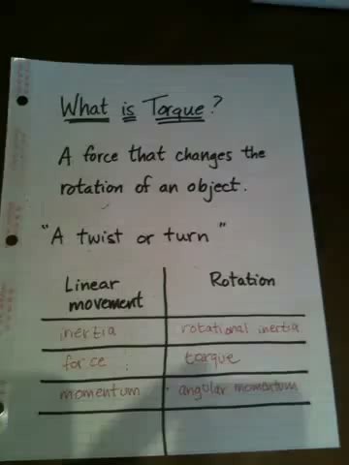
Introductory Video

Slide 16
Center of Mass
CM

Slide 17
Center of Mass

Slide 18
Center of Mass
CM

Slide 19
Center of Gravity
CM
m₁g
m₂g
m_{system}g

Slide 20
Center of Gravity
m₁g
m₂g
Pivot point or fulcrum

Slide 21
Center of Gravity
What’s gonna happen?
m₁g
Pivot point or fulcrum

Slide 22
Torque
Torque happens!
Pivot point or fulcrum
m₁g

Slide 23
Center of Gravity
Torque happens!
m₁g
Pivot point or fulcrum

Slide 24
Torque – Case 1
m₁g
m₂g
Pivot point or fulcrum

Slide 25
Torque – Case 2
m₁g
Pivot point or fulcrum

Slide 26
Torque – Case 3
m₁g
m₂g
Pivot point or fulcrum

Slide 27
Torque – Case 4
m₁g
m₂g
Pivot point or fulcrum

Slide 28
Torque
Torque is:
The moment of the force about the axis
Another name for angular acceleration
m₁g
Pivot point or fulcrum

Slide 29
Torque Is
The product of the force times the lever or moment arm. The lever arm is the distance between the force and the axis of rotation
or pivot point or fulcrum
m₁g
Pivot point or fulcrum

Slide 30
Torque
Since torque is force times distance, it stands to reason that the units will be Newton-meters (N⋅m), or Joules (Work)
m₁g
Pivot point or fulcrum

Slide 31
Torque
If the blue box is 10kg and 30cm from the pivot point, how much torque is produced and in what direction?
m₁g
Pivot point or fulcrum

Slide 32
Torque
If the blue box is 10kg and 30cm from the pivot point, how much torque is produced and in what direction?
m₁g
Pivot point or fulcrum

Slide 33
Torque
How much force would have to be applied 10cm from the pivot to balance the box?
F_{P}
m₁g
Pivot point or fulcrum

Slide 34
Torque
What if the force is applied at a 45° angle?
F_{P}
m₁g
Pivot point or fulcrum

Slide 35
Torque
What if the force is applied at a 45° angle?
You still need a vertical force of 294 Nm, so the applied force must be a lot greater.
294 Nm
F_{P}
m₁g
Pivot point or fulcrum

Slide 36
Torque
What if the force is applied at a 45° angle?
294 Nm
F_{P}
45°
m₁g
Pivot point or fulcrum

Slide 37
Let’s play with stuff

Slide 38
Learning Objective(s):
The student is able to use representations of the relationship between force and torque.
The student is able to compare the torques on an object caused by various forces.
The student is able to estimate the torque on an object caused by various forces in comparison to other situations.

Slide 39
Learning Objective(s):
The student is able to design an experiment and analyze data testing a question about torques in a balanced rigid system.
The student is able to calculate torques on a two-dimensional system in static equilibrium, by examining a representation or model (such as a diagram or physical construction).
The student is able to make predictions about the change in the angular velocity about an axis for an object when forces exerted on the object cause a torque about that axis.

Slide 40
Learning Objective(s):
The student is able to plan data collection and analysis strategies designed to test the relationship between a torque exerted on an object and the change in angular velocity of that object about an axis.
The student is able to predict the behavior of rotational collision situations by the same processes that are used to analyze linear collision situations using an analogy between impulse and change of linear momentum and angular impulse and change of angular momentum.

Slide 41
Learning Objective(s):
In an unfamiliar context or using representations beyond equations, the student is able to justify the selection of a mathematical routine to solve for the change in angular momentum of an object caused by torques exerted on the object.
The student is able to plan data collection and analysis strategies designed to test the relationship between torques exerted on an object and the change in angular momentum of that object.

Slide 42
Learning Objective(s):
The student is able to describe a representation and use it to analyze a situation in which several forces exerted on a rotating system of rigidly connected objects change the angular velocity and angular momentum of the system.

Slide 43
Learning Objective(s):
The student is able to plan data collection strategies designed to establish that torque, angular velocity, angular acceleration, and angular momentum can be predicted accurately when the variables are treated as being clockwise or counterclockwise with respect to a well-defined axis of rotation, and refine the research question based on the examination of data.

Slide 44
Essential Knowledge(s):
Only the force component perpendicular to the line connecting the axis of rotation and the point of application of the force results in a torque about that axis.
The lever arm is the perpendicular distance from the axis of rotation or revolution to the line of application of the force.
The magnitude of the torque is the product of the magnitude of the lever arm and the magnitude of the force.
The net torque on a balanced system is zero.

Slide 45
Essential Knowledge(s):
The presence of a net torque along any axis will cause a rigid system to change its rotational motion or an object to change its rotational motion about that axis.
Rotational motion can be described in terms of angular displacement, angular velocity, and angular acceleration about a fixed axis.
Rotational motion of a point can be related to linear motion of the point using the distance of the point from the axis of rotation.
The angular acceleration of an object or rigid system can be calculated from the net torque and the rotational inertia of the object or rigid system.

Slide 46
Essential Knowledge(s):
A torque exerted on an object can change the angular momentum of an object.
Angular momentum is a vector quantity, with its direction determined by a right-hand rule.
The magnitude of angular momentum of a point object about an axis can be calculated by multiplying the perpendicular distance from the axis of rotation to the line of motion by the magnitude of linear momentum.
The magnitude of angular momentum of an extended object can also be found by multiplying the rotational inertia by the angular velocity.
The change in angular momentum of an object is given by the product of the average torque and the time the torque is exerted.

Slide 47
Essential Knowledge(s):
Torque, angular velocity, angular acceleration, and angular momentum are vectors and can be characterized as positive or negative depending upon whether they give rise to or correspond to counterclockwise or clockwise rotation with respect to an axis.

Slide 48
Enduring Understanding(s):
A force exerted on an object can cause a torque on that object.
A net torque exerted on a system by other objects or systems will change the angular momentum of the system.

Slide 49
Big Idea(s):
Big Idea 3: The interactions of an object with other objects can be described by forces.
Big Idea 4: Interactions between systems can result in changes in those systems.

Slide 50
Questions?

Slide 51
Homework
#22-26

Slide 52
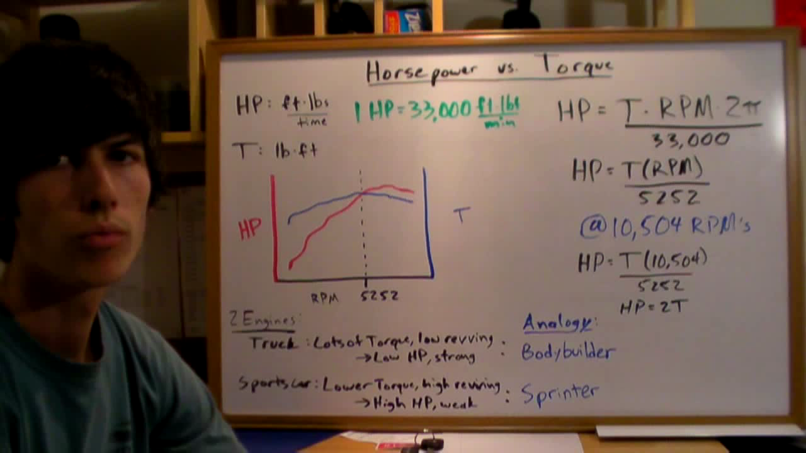
Video: torque vs. horsepower

