Slide 1
Devil physics The baddest class on campus IB Physics AP Physics

Slide 2
Everything you wanted to know about devil physics . . . and a lot of stuff you didn’t

Slide 3
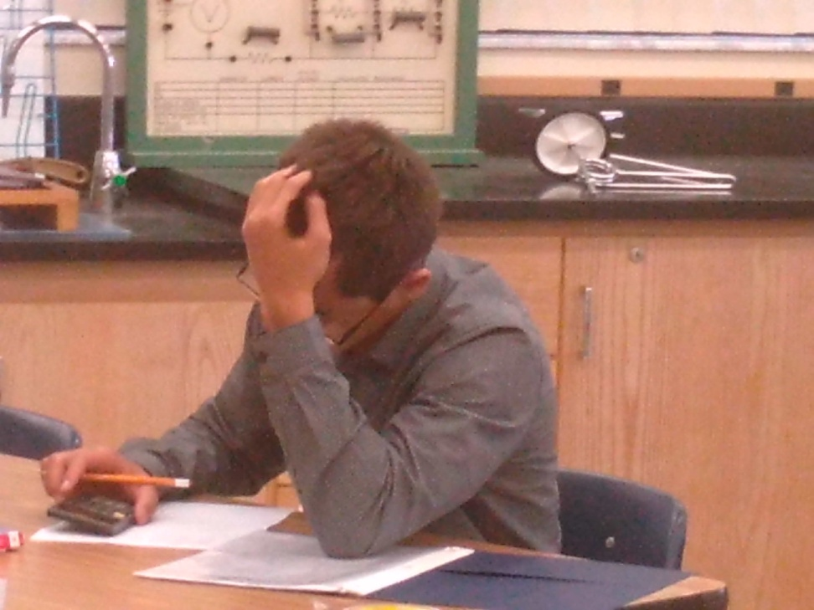
And this is testable

Slide 4
Class Motto
Man’s Flight Through Life is Sustained by the Power of His Knowledge

Slide 5
Class Theme
Reaching higher and higher,
Because that’s what dreams are made of.

Slide 6
Class Theme

Slide 7
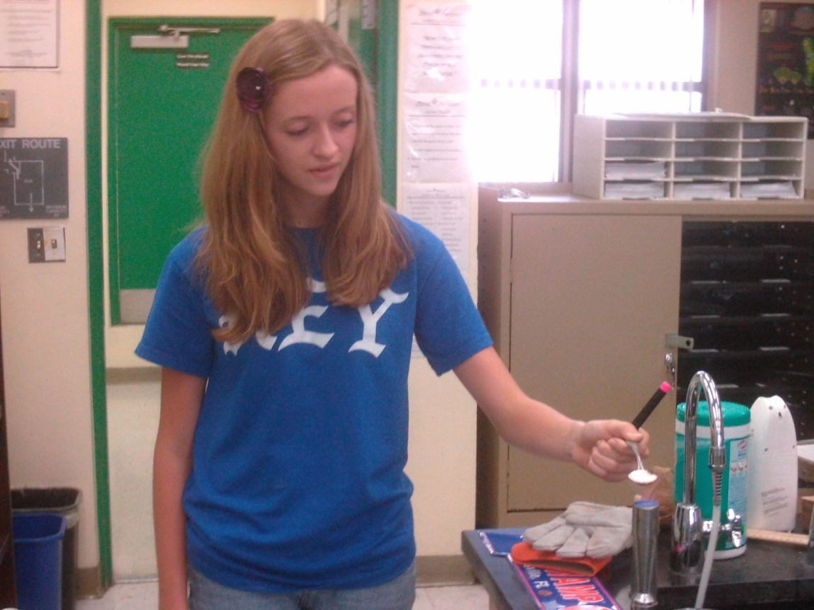
Safety
Fire
Adverse Weather
Lockdown
Bathroom Pass

Slide 8
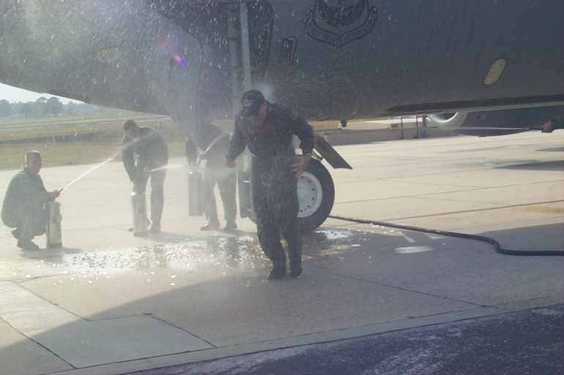
Who Is This Guy?
Northeast High School
BS, Engineering & History, USAFA
MAS, Aeronautical Science, Embry-Riddle
USAF KC-135 Instructor/Evaluator Pilot
Middle School Math
Devil Physics
Gator at Heart

Slide 9
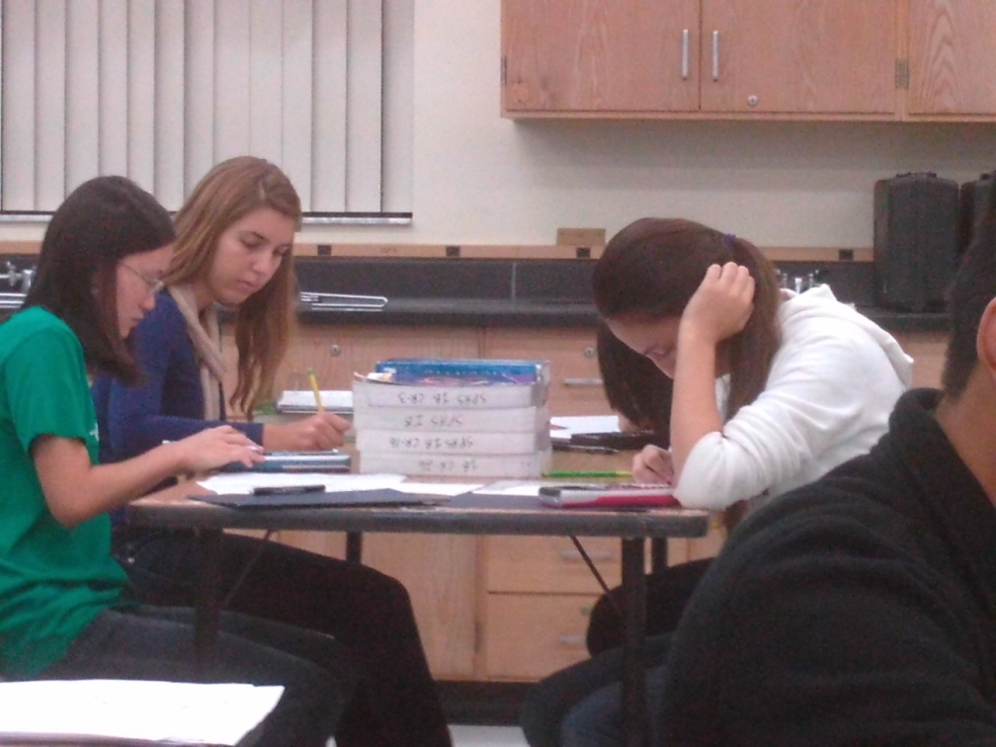
Assigned Seats
There is a method to the madness
Cooperative Learning – Not Cheating
Homework review
Attendance

Slide 10
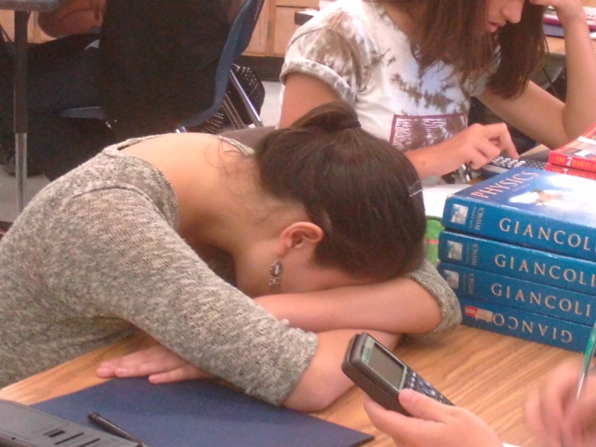
Block Period SOP:
Standard Day:
Review and Correct Homework from previous Class
Lecture on Section(s) and Assign Homework Problems
Assign Reading Activity for next Section
Supplemental Reading Activities
Labs
Test Review
Chapter Test
Skinny periods

Slide 11
Turning In Assignments
Homework handwritten hardcopy
Reading Activities, Supplemental Reading Activities, Lab Reports
Printed, Handwritten, Hardcopy
Typed, Printed, Hardcopy
Typed, Uploaded to Focus (preferred)
Assignments may be e-mailed only under extreme duress (like deathbed)
Filename “SmithKPer67BReadAct3-4”

Slide 12
Grades
Total Points System
Reading Activities
3 points max if turned in prior to class lecture (due date)
2 points max if turned in within 1 week of due date
1 point if turned in before test
Homework Problems
3 points max if turned in during the class HW Review (due date)
2 points max if turned in within 1 week of due date
1 point if turned in before test

Slide 13
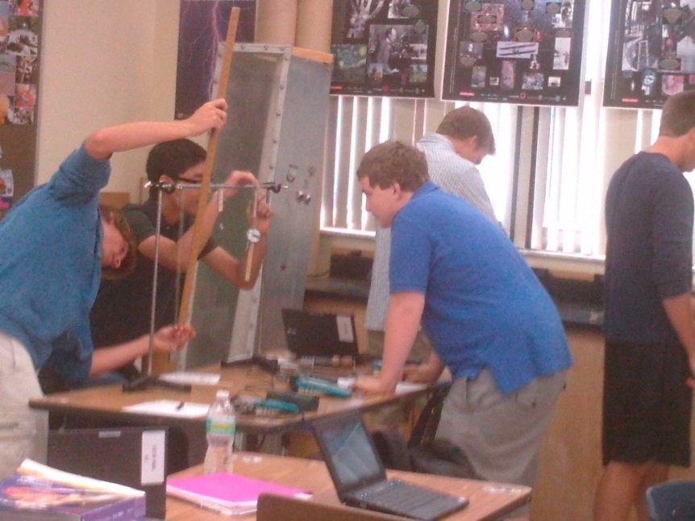
Grades (cont.)
Labs
20-40 points
1 every two weeks
Minus 10% per calendar day after due date
Chapter Tests
30-40 points each
Make-up tests
Different, Harder, Longer
IB Curve

Slide 14
IB Curve
Example: Score 30/40
40% ➔ 63% +23%
50% ➔ 71% +21%
60% ➔ 77% +17%
70% ➔ 84% +14%
80% ➔ 89% +9%
90% ➔ 95% +5%
Requirements
All HW in by test day
Complete Test Review
Take test on test day
Computation
Convert score to decimal
Take square root
Convert new decimal to new score

Slide 15
Extra Credit
Cash only; no credit cards, checks or money orders (just kidding)
End of the grading period, within 2% of the next higher letter grade
4-page paper on a past Nobel Prize winner in Physics
Who What
When Why
Where How
Posted on website – Important Information
Can’t do one that’s already been done

Slide 16
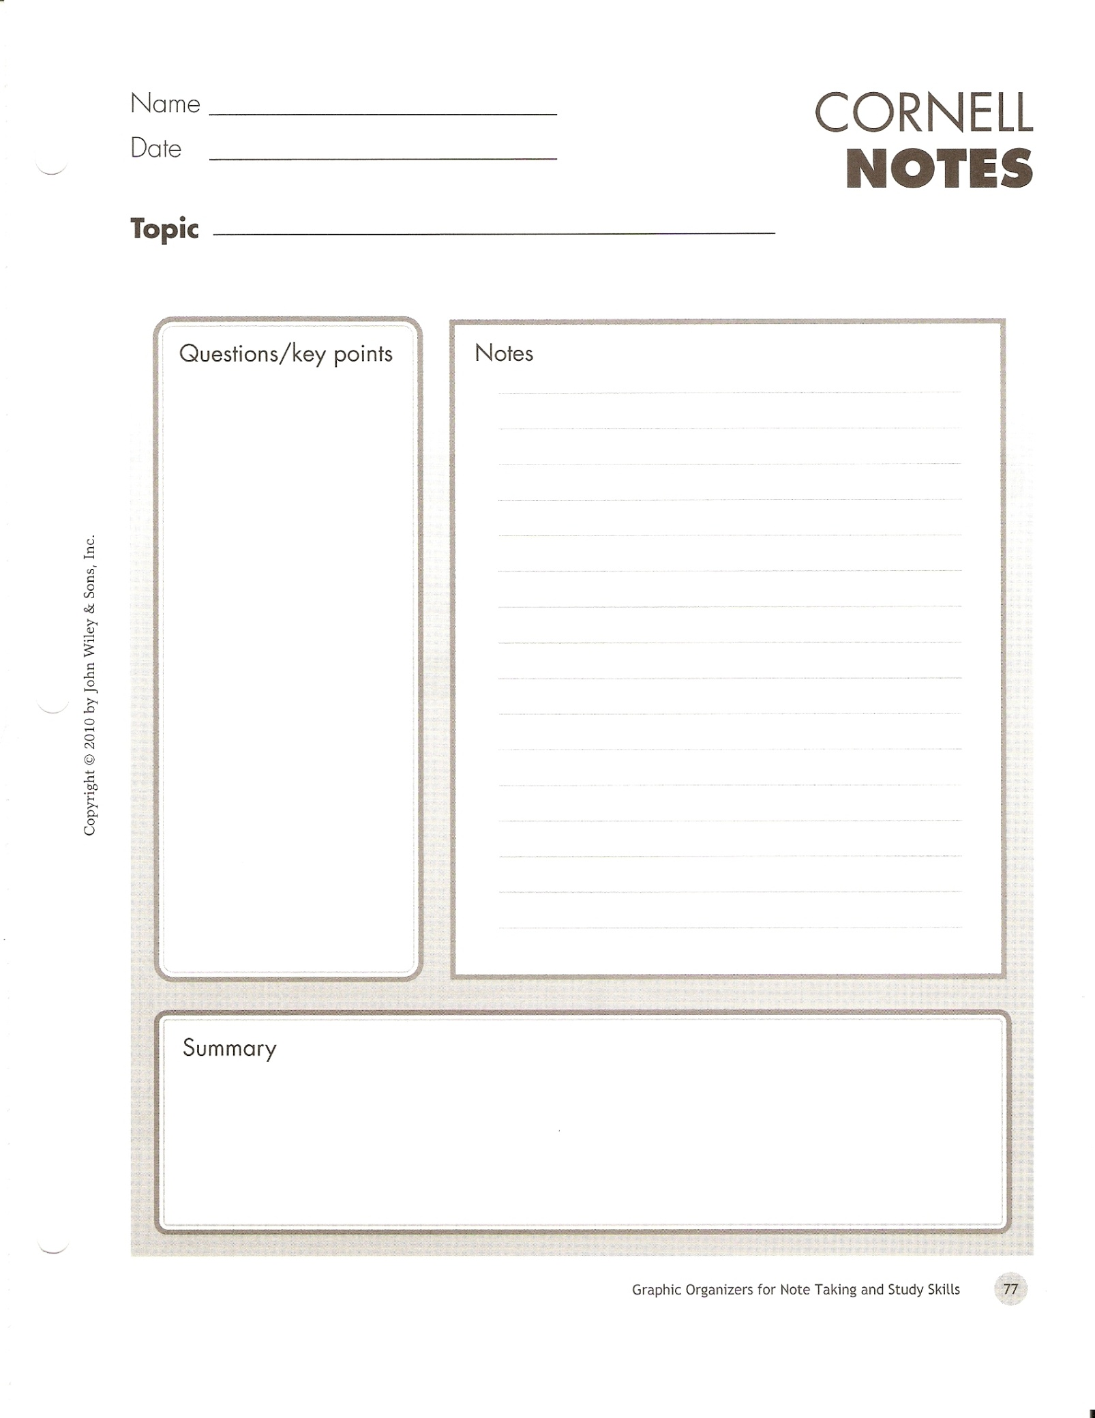
Taking Notes
AVID – Cornell Notes

Slide 17
What You Need
Textbook
Pencil – for computations
Pen for notes
Blue or red pen for correcting homework
Notebook paper
Scientific calculator
Memory stick (needed to save work when working with the Box O’Laptops)
Water bottle – preferably a reusable metal one
Computer/Printer/Internet/E-Mail/MS Word/MS Excel access at home – let me know ASAP if you don’t have this
E-mail address – see above
Student resource center available in cases of Student Emergencies

Slide 18
Conduct and Academic Performance
Conduct infractions will be dealt with in accordance with the SPHS Discipline Policy
Failure to Meet Expectations. I will follow the guidelines set forth in the SPHS Response to Intervention (RTI) procedures. In general, if a student fails to meet the expectations of this class, they can expect:
An individual conference with the teacher
Phone call to the parents
Conference with the student and parents
Referral to appropriate staff agency (disciplinary or academic) for intervention
For IB Students, failure to maintain academic standards will be dealt with in accordance with SPHS IB Policies and Procedures

Slide 19
Conduct and Academic Performance
The SPHS IB Honor Code and the IBO Standards of Integrity will be strictly enforced
Zero Tolerance
Give No Quarter, Take No Prisoners

Slide 20
Class Rules
We will not lie, cheat or steal, nor tolerate among us anyone who does. (USAF Academy Honor Code)
We will respect ourselves and others.
We will act professionally at all times.
We will put forth our best effort.

Slide 21
Expectations
Teacher and students will come to class.
Teacher and students will come to class on time.
Teacher and students will come to class prepared to teach/learn with all needed materials.

Slide 22
Expectations (Cont.)
Students will complete homework assignments as soon as possible after material has been presented.
Teacher will grade all assignments as soon as possible but no later than one week after turn in (two weeks for labs and tests).
Teacher will put all grades into the grading system by midnight every Sunday so it is visible to students and parents.

Slide 23
Expectations (Cont.)
Students will seek help whenever anything is not understood.
Teacher will be available for extra help after school a minimum of 1.5 hours per day, three days per week.

Slide 24
Expectations (Cont.)
Students will place safety as the paramount concern at all times and especially when performing lab experiments.
Teacher will provide a physically and emotionally safe working environment for students at all times.
Teacher and students will give their best effort in all endeavors.

Slide 25
My Approach to Teaching

Slide 26
Important Websites
Devil Physics
http://sphsdevilphysics.weebly.com/index.html#/
Google ‘Devil Physics’
Portal (Grades)
Know your login and password
https://portal.pcsb.org/focus/index.php
SPHS
http://www.stpetehigh.com/

Slide 27
Curriculum – AP Physics
Ch | Topics – First Semester
1 | Introduction, Measurement, Estimating
2 | Describing Motion; Kinematics in One Dimension
3 | Kinematics in Two Dimensions; Vectors
4 | Dynamics: Newton’s Laws of Motion
5 | Circular Motion; Gravitation
6 | Work and Energy
7 | Linear Momentum

Slide 28
Curriculum – AP Physics
Ch | Topic – Second Semester
8 | Rotational Motion
11 | Vibrations and Waves
16 | Electric Charge and Electric Field
18 | Electric Current
19 | DC Circuits

Slide 29
Curriculum – IB Physics-1
IB Physics - 1
IB Physics – 2,3
1 – Measurements and Uncertainties
2 – Mechanics
3 – Thermal Physics
4 – Waves
5 – Electricity and Magnetism
6 – Circular Motion and Gravitation
Internal Assessment
7 – Atomic, Nuclear and Particle Physics
8 – Energy Production
9 – Wave Phenomena
10 – Fields
11 – Electromagnetic Induction
12 – Quantum and Nuclear Physics

Slide 30
Academic Goals
Complete the IB/AP curriculum
Complete required lab hours
All students receive a final grade of 5-7 (IB) or 3-5 (AP)
All students see dramatic increases in their self-efficacy toward physics and are motivated to continue their learning in a Physics-related discipline.

Slide 31
IB Physics Only
IB LEARNER PROFILE
IB Academic Guidelines
SPHS IB Honor Code
SL Physics Brief
HL Physics Brief
SL/HL Syllabus

Slide 32
Questions?

Slide 33
Still not Inspired?

